Slide 1
Swift: Core+
Developed by: Avi, Ayush, Casey, and Ethan
Group 2
Notes:
Ayush

Slide 2

Language Paradigm
Very similar readability to C++ and Python
Functional programming language compared to C’s block syntax style
Utilizes lambda calculus
Inputs are sent to functions that produce outputs
Logic is easier due to code duplication
Logic is created the same way for all classes
Reactive Programming
Notes:
Ayush

Slide 3

Evolution of Swift
Created in 2010 by Chris Lattner
Creator of LLVM and Clang
Wanted to create a better developing tool with a C-like compiler
With help of Apple software team Shiny was created
Alternative to Objective-C programming
ARC and other features were added to Shiny and was renamed Swift
Swift was not open-source but after Swift 2.2 was released and made open-source under Apache License 2.0
Notes:
Ayush

Slide 4

Swift vs Other Languages
Rapid development process
Much easier to read compared to other programming languages, but with it being a new languages causes it harder to learn and write
Syntax is concise yet expressive
Similarities to other languages
No semicolons like Python
Low level primitives
Types
Flow control
Operators
Object-oriented
Classes, protocols, and generics
Notes:
Ayush

Slide 5








Swift Companies
Notes:
Ayush

Slide 6

Best Features
Simplified syntax and grammar
Less code involved/less effort
Easier scaling than other languages
Faster development time
40% performance increase vs Objective-C Programming
Algorithms require significantly less runtimes then C or Python
Static and dynamic memory libraries
Relatively easy to learn
Notes:
Avi

Slide 7
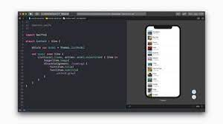

Best Features continued
SwiftUI
Easy to learn due to declarative syntax
Live Previews
Shows preview of code being written on a simulated apple device
Fast!
SwiftUI re-renders the views as they are modified by the programmer
Includes many basic apple functions
Cross platform user interface
tvOS, macOS, iOS and watchOS
Notes:
Avi

Slide 8


Cons of using Swift
Difficult to work with on Windows
Works best on Xcode on macOS
Xcode crashes on older Mac computers
Very unstable with other applications open
Documentation less common than other languages we’ve used before
Some versions are not backwards compatible
SwiftUI is restrictive and sometimes irregular
Notes:
Avi

Slide 9
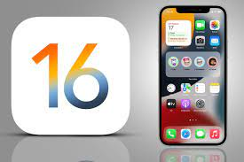
Best Applications of Swift
Initially created by apple
Applications work best on:
iOS
macOS
Apple computers are also best for programming swift in xcode
Notes:
Avi

Slide 10
Core+ Demo
Notes:
Casey

Slide 11

HomePageView - Landing Page
Displays list of muscle groups
Legs
Chest
Back
Shoulders
Arms
Nav Link: “Muscle Group” Button
View exercises in selected muscle group
NavLink: “My Workouts” Button
Page: WorkoutPlanView
View personal workout plans
Notes:
Casey

Slide 12
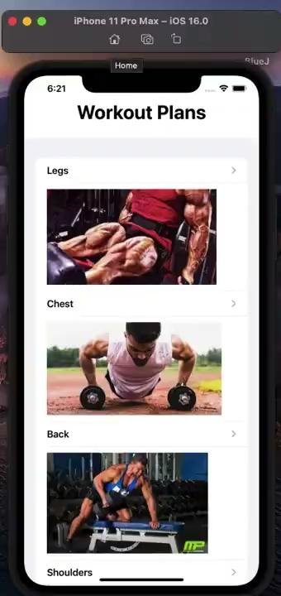
ExerciseView - List of Exercises
Displays list of all exercises in selected muscle group
Nav Link: “Exercise” Button
Page: WorkoutView
Details about selected exercise
Notes:
Casey

Slide 13
DescriptionView - Description of Exercise
Details include:
Image
Name
Type
Description
Notes:
Casey

Slide 14
Back to Home Page
Notes:
Ethan

Slide 15
MyWorkoutPlan - View Workout Plan
Select workout plan for the day based on muscle group
Nav Link: “Plan” button
Page: ListView
Display selected workout plan
Notes:
Ethan

Slide 16
ListView/ Addview - View and Manage Workout Plan
ListView:
View and manage custom workout plan
Select an exercise to see details
Function: Check exercises
Select exercises that have been completed
Displays a green check instead of a red circle
Function: Swipe to delete
Remove exercise from the list
AddView:
View all exercises in selected muscle group
Select exercises to add
Notes:
Ethan

Slide 17
Questions
Notes:
All

